Slide 1
Properties of Waves
Physical Science 20 – Ms. Hayduk

Slide 2
Wave Terminology

Slide 3
What is a Wave?
Occurs when there is a movement of ___________________________ without movement of ___________________________
___________________________ wave: disturbance that travels through a medium (a ___________________________)

Slide 4
Wave Movement
Due to _____________________________________________________ in a medium
___________________________ displacement – particles return to original position after energy is transferred
Categories of wave movement:
Notes:
Demo: do the wave!

Slide 5
Transverse Waves
Particles move ___________________________ to wave direction
Examples: light, waves on a string

Slide 6
Longitudinal Waves
Particles move ___________________________ to wave direction
Example: sound

Slide 7
Surface Waves
Particles move in a ___________________________ path
Surface particles move most, and motion decreases with distance from the surface
Example: water waves
Notes:
Visual aid: http://www.acs.psu.edu/drussell/Demos/waves/wavemotion.html

Slide 8
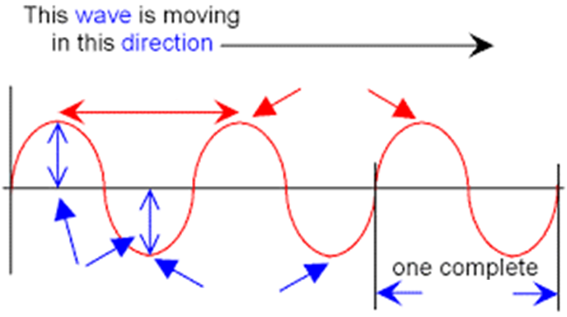
Parts of a Wave

Slide 9
Parts of a Wave

Slide 10
The Wave Equation

Slide 11
Recall: Speed
v is speed, d is distance, t is time

Slide 12
Example 1: Speed
A sound wave caused by a thunder strike travels at 331 m/s in air. You hear the thunder 3.4 s after you see the lightning (which you see instantly after it strikes). How far away is the storm?
Notes:
1125.4 m = 1.1 km

Slide 13
Wavelength and Period
___________________________ (λ): distance between corresponding points on two wave pulses
___________________________ (T): time to complete one cycle

Slide 14
Example 2: Wavelength
A student counts six full wave cycles in a square tank full of water. The tank is 43 cm long. What is the wavelength of the water waves?
Notes:
7.2 cm

Slide 15
Frequency
___________________________ (f): number of wave pulses passing a point in a specific amount of time (one second)
Measured in Hertz (Hz), or 1/s
Inversely proportional to period – f  as T

Slide 16
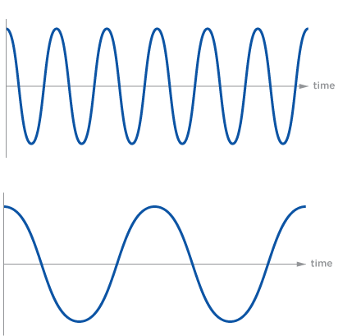
Frequency

Slide 17
Example 3: Period & Frequency
A boat bobs up and down 18 times in 52 seconds. What is the period of the waves? What is the frequency?
Notes:
T = 2.9 s f = 0.35 Hz

Slide 18
The Wave Equation
Relates wave speed with frequency and wavelength

Slide 19
Example 4: Wave Equation
A harp string produces a sound wave with a wavelength of 1.50 m and a frequency of 220.0 Hz. What is the speed of the wave?
Notes:
V = 330 m/s

Slide 20
Example 5: Wave Equation
A buoy in the ocean bobs up and down. The wave crests are 2.35 m apart. The buoy reaches it maximum height every 1.21 s. What is the speed of the waves?
Notes:
V = 1.94 m/s

Slide 21
General Wave Behaviour

Slide 22
General Rules of Waves
_________________ depends ONLY on ______________________
___________________________ depends ONLY on rate at which wave is generated; not affected by change in medium
___________________________ is independent of other factors; shows how much ___________________________ wave is transmitting

Slide 23
Definitions
Boundary behaviour: how waves react when it changes medium (at an ___________________________)
1D waves: travel in only one direction (e.g. along a string)
2D waves: travel in two directions, along a surface (e.g. water waves)

Slide 24
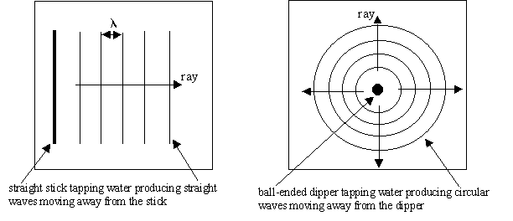
Definitions
___________________________ waves: formed when the force creating waves is equally distributed along the surface of the medium
___________________________ waves: formed from a point disturbance

Slide 25
One-Dimensional Waves

Slide 26
1D End Behaviour
___________________________ reflection: end of medium is held steady, particles cannot freely move
Some energy reflects back, some is transmitted to the object holding the end
Reflected pulse is ___________________________
___________________________ reflection: end of medium is not fixed in place, little interaction between particles
Reflected pulse is ___________________________
Notes:
https://www.youtube.com/watch?v=ZxIlyptT1FY

Slide 27
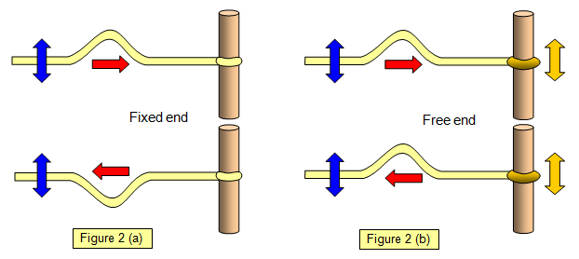
1D End Behaviour

Slide 28
1D End Behaviour
Reflected pulse will always have:
______________________________________________________
______________________________________________________
______________________________________________________

Slide 29
Change in Density of Medium
Waves travel ___________________________ if there is:
___________________________ tension in the string/spring
___________________________ or ___________________________ string/spring
At interface:
Some energy is reflected back (same speed and wavelength)
Wavelength and wave speed will change in new medium
Notes:
Demo: fat to skinny slinky
https://www.youtube.com/watch?v=TfYCnOvNnFU

Slide 30
Interference
___________________________ : effect that occurs when two waves meet within the same medium
Medium takes on the ___________________________ of the amplitude of the individual waves
___________________________ : waves with same displacement direction add to make a larger pulse
___________________________ : waves with opposite displacement direction subtract to make smaller pulse

Slide 31
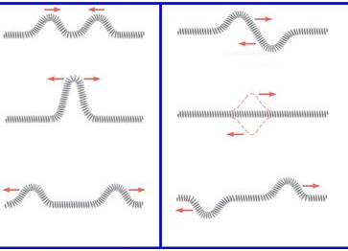
Interference
Notes:
https://www.youtube.com/watch?v=4TT-9s51J4c
https://www.youtube.com/watch?v=kTKTcGBjWZ0

Slide 32
Two-Dimensional Waves

Slide 33
Reflection
___________________________ : redirection of waves at an interface into the original medium
Waves remain in original medium, but in a different direction from incident waves
Law of Reflection:

Slide 34
Reflection

Slide 35
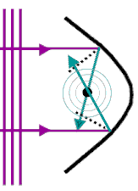
Reflection
Straight waves hitting a curved surface will ___________________________ (reflect towards each other in a circular shape) or ___________________________ (reflect away)
Notes:
https://youtu.be/3QiK4gR8Svs?t=151
https://youtu.be/3QiK4gR8Svs?t=268

Slide 36
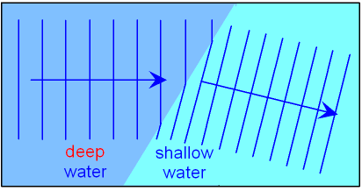
Refraction
___________________________ : the redirection of waves at an interface into a new medium
Waves speed up or slow down, depending on the medium (e.g. change in water depth)
Notes:
https://www.youtube.com/watch?v=tUqoYhfPMcU

Slide 37
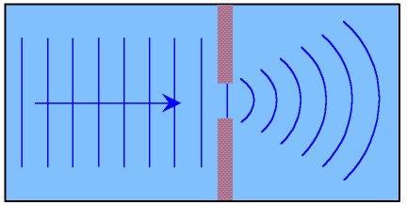
Diffraction
___________________________ : effect when waves change direction as they pass through an opening or move around a barrier (no medium change)
More diffraction when waves are moving ___________________________ (___________________________ wavelength)

Slide 38
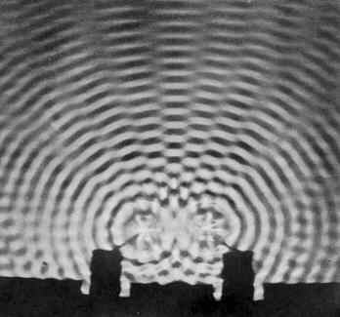
Interference
Notes:
http://falstad.com/ripple/index.html

Slide 39
Sound Waves

Slide 40
Basics of Sound
Mechanical wave originating from a vibrating object (e.g. vocal cords, guitar string), longitudinal
Human ears can hear between 20 Hz and 20 000 Hz
Above is ___________________________, below is ___________________________
___________________________ is another way of saying frequency
Notes:
Why can’t sound travel through space?

Slide 41
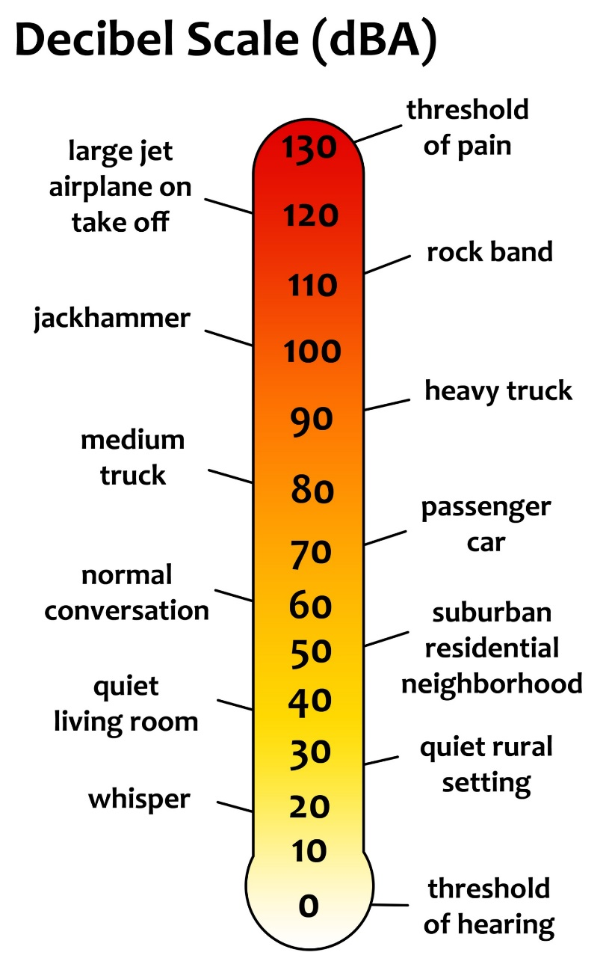
Sound Intensity
___________________________ is amount of energy transported in a sound wave, directly related to amplitude
___________________________ : faintest sound humans can hear
Measured in ___________________________ (dB), a logarithmic scale (each step is 10x more intense than previous step)
Notes:
https://www.youtube.com/watch?v=VxcbppCX6Rk
https://www.youtube.com/watch?v=qV4lR9EWGlY
https://www.youtube.com/watch?v=btgAUdbj85E

Slide 42
Speed of Sound
Depends on medium and temperature
Fastest and furthest in solids, then liquids, then gases (e.g. about 4x faster and further in water than air)
Speed of sound in air:
(T is temperature in °C)

Slide 43
Example 1: Speed of Sound
Determine the speed of sound if the temperature is 4.0°C.
Notes:
v = 333 m/s

Slide 44
Example 2: Speed of Sound
You do some calculations and determine the speed of sound to be 365 m/s. What is the air temperature?
Notes:
T = 57°C

Slide 45
Example 3: Speed of Sound
The temperature outside on a warm summer evening is 28°C. You see a flash of lightning, then thunder rumbles 4.0 seconds later. How far away is the storm?
Notes:
d = 1391 m = 1.4 km

Slide 46
Echoes
___________________________ : reflection of a sound wave
Can determine speed of sound using distance to boundary (and back) and time between sound and echo
Notes:
https://www.youtube.com/watch?v=laeE4icRYp4

Slide 47
Example 4: Echoes
The air temperature is 5°C. You stand 100 m from a wall and clap your hands 10 times. You clap every time you hear the echo of the previous clap. It takes 6.1 s from the first clap to the echo of the last clap.
What is the speed of sound based on the echo?
What is the speed of sound based on air temperature?
Why might these values be different?
Notes:
a. 328 m/s
b. 334 m/s
https://www.youtube.com/watch?v=Gy7HqToiBvo

Slide 48
Light and Optics

Slide 49
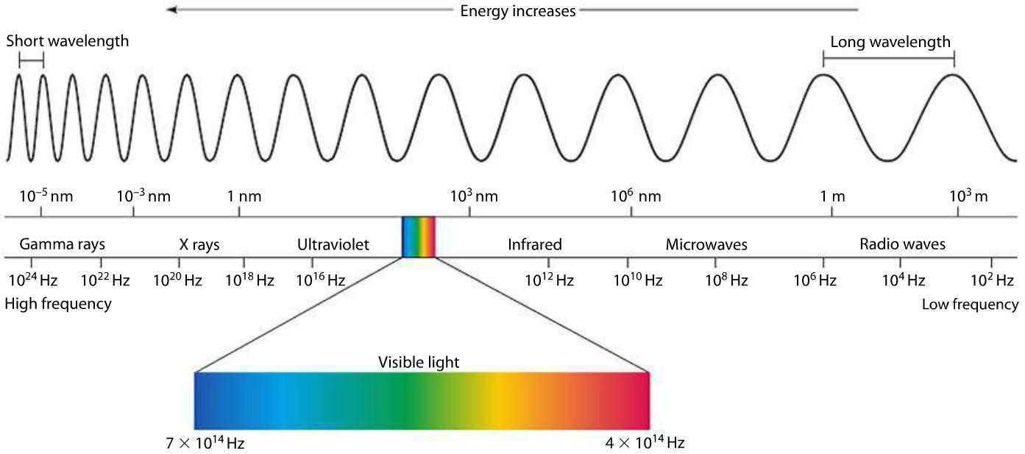
Electromagnetic Spectrum
___________________________ wave: waves that do not need a medium to propagate

Slide 50
Light
Travels in straight lines only (___________________________), because it moves so fast
Speed of light in a vacuum, c, is ___________________________

Slide 51
Reflection of Light

Slide 52
Reflection of Light
Recall: Law of Reflection
angle of incidence = angle of reflection
Reflection is more complex with curved surfaces (concave and convex mirrors)
___________________________ : a method for determining path of light and resulting images as it reflects or refracts through an object or medium

Slide 53
Image Characteristics
Notes:
Demo: Pig Optical Illusion

Slide 54
Image Characteristics
Notes:
Demo: Pig Optical Illusion

Slide 55
Plane Mirrors

Slide 56
Ray Diagrams for Plane Mirrors
Used to determine image location
___________________________(and a protractor, when needed)
Rules:
Two rays from each “corner” of the image
Law of Reflection
Extend rays behind the mirror to find the image
Notes:
Plane Mirror Ray Diagrams Example Sheet

Slide 57
Ray Diagrams for Plane Mirrors

Slide 58
Curved Mirrors

Slide 59
Parts of Curved Mirrors
___________________________ : curves towards viewer, also called converging
___________________________ : curves away from view, also called diverging
___________________________, C: the centre of the mirror if shape was extended to make a circle
___________________________, F: halfway between C and mirror
___________________________, V: the centre point of the mirror, where the principal axis (___________________________) hits the mirror

Slide 60
Ray Diagrams for Curved Mirrors
Pick two rays starting from the top of the object:
Approaches parallel to the normal, reflects through F
Approaches through F, reflects parallel to the normal
Approaches through C, reflects back through C
Hits the mirror at V, reflects according to Law of Reflection
If rays are diverging on object side of mirror, extend reflected rays behind the mirror

Slide 61
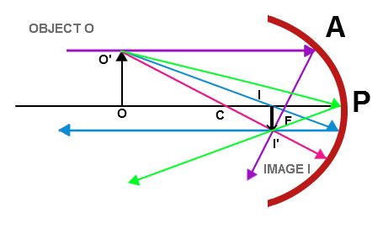
Ray Diagrams for Concave Mirrors

Slide 62
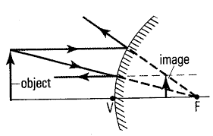
Ray Diagrams for Convex Mirrors
Notes:
https://www.youtube.com/watch?v=Oh4m8Ees-3Q

Slide 63
Refraction of Light

Slide 64
Recall: Refraction
Refraction happens when a wave changes medium

Slide 65
Refractive Index
___________________________, n: ratio between speed of light in a substance and speed of light in a vacuum (c)
No units
Higher value → light moves slower → light bends more

Slide 66
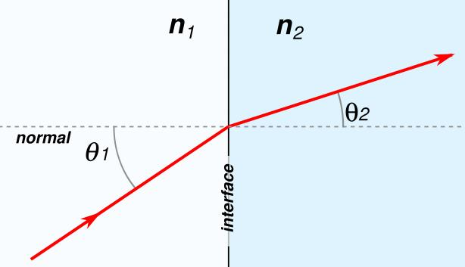
Snell’s Law
Incident and refracted rays are on opposite sides of the normal and in the same plane
Snell’s Law:

Slide 67
Example: Snell’s Law
Light travels from glass into water. The angle of incidence in the crown glass is 40.0°. What is the angle of refraction?

Slide 68
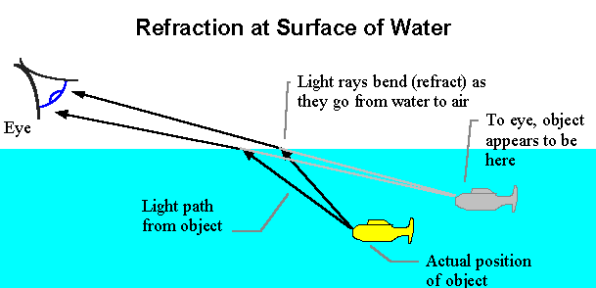
Surface Refraction

Slide 69
Total Internal Reflection
___________________________ : occurs when ray hits boundary at a large enough angle that all light is reflected, none refracted
Occurs when n₁ > n₂
Minimum angle for this to occur is called ___________________________
Notes:
Demo: Fibre Optic Light
https://www.youtube.com/watch?v=0MwMkBET_5I

Slide 70
Example: Critical Angle
Determine the critical angle of diamond (n = 2.42) when surrounded by:
Air
Water

Slide 71
Refraction in Lenses

Slide 72
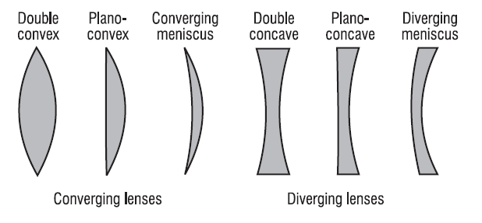
Lenses
___________________________ : a transparent device with at least one curved surface that refracts light
Can be converging or diverging

Slide 73
Parts of Lenses
___________________________ : vertical centre line through the lens
___________________________ : point where the principal axis meets optical axis
If curved on both sides, lenses will have two focal points

Slide 74
Ray Diagrams for Converging Lenses
Pick two rays starting from the top of the object:
Approaches OA parallel to normal, refracts through F on opposite side
Approaches OA through F on object side, refracts parallel to normal
Passes through optical centre
If refracted rays are diverging, extend them on object side of lens

Slide 75
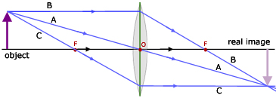
Ray Diagrams for Converging Lenses

Slide 76
Ray Diagrams for Diverging Lenses
Pick two rays starting from the top of the object:
Approaches OA parallel to normal, refracts through F on object side
Approaches OA toward F on opposite side, refracts parallel to normal
Passes through optical centre
All rays will diverge, extend all refracted rays on both sides of lens

Slide 77
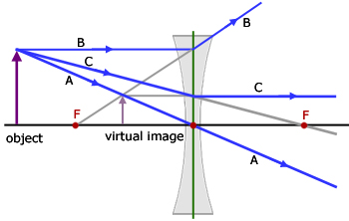
Ray Diagrams for Diverging Lenses
Notes:
https://www.youtube.com/watch?v=pfz-6Iz24Zs
https://www.youtube.com/watch?v=Ef2_aaYpZSI

